Slide 1
Using M2M:
Programmatic Interaction with OOI Data & Metadata
Andrew Reed - OOI Coastal & Global Scale Nodes
OOI NE Pacific Community Workshop
Tuesday, June 7, 2022

Slide 2
OOI’s API: Machine-to-Machine (M2M)
What is M2M?
M2M is the name for OOI’s Application Programming Interface (API)
M2M allows for the programmatic access (i.e. scripting) to OOI’s data and metadata
Allows for download of data in JSON, netCDF, and csv formats from OOI’s THREDDS server
Language agnostic:
Examples principally utilize either Python or MatLab
Developing user base for sharing of code and analysis (https://github.com/oceanobservatories/ooi-data-explorations)
What is accessible?
Metadata
Calibrations
Deployment Information
Data
Fast synchronous requests returned as a JSON object but limited data (<20,000 data points)
Slower asynchronous requests returned as either JSON, CSV, or netCDF with no data point limit
Annotations
Key Handouts
API Cheat Sheet
OOI Decoder Sheet
OOI Instrument List

Slide 3
Terminology (Handout: Decoder)
Array
One of 5 major research components that make up OOI (e.g. Ocean Station Papa or Coastal Endurance)
Site
A specific geographic location within an array (e.g. Global Ocean Station Papa Flanking Mooring A = GP03FLMA)
Platform
A set of infrastructure within an array that host a complement of integrated scientific instrument. May be fixed (mooring) or mobile (profilers or gliders)
Node
A section of a platform with one or more computers and power controllers. Instruments on platforms are plugged into nodes. (e.g. mooring riser on Global Ocean Station Papa Flanking Mooring A = GP03FLMA-RIS01)
Instrument/Sensor
Terms often used interchangeably. An instrument is a piece of equipment used to collect data. A sensor is a part of an instrument which measures a specific quantity.
Each instrument has a Unique ID (UID)
Reference Designator
Identifies a particular instrument on a particular node/platform at a particular site.
Example: GP03FLMA-RIS01-02-DOSTAD000 = Global Ocean Station Papa Flanking Mooring A - Mooring Riser - Dissolved Oxygen Sensor
Method
Telemetered: Data returned wirelessly. Often truncated or decimated due to size.
Recovered_host/Recovered_inst: Data downloaded directly from either the mooring computer or from the instrument.
Streamed: Data accessible nearly instantaneously. Limited to cabled array and Endurance shelf stations
Data Stream
Raw data feed from a sensor that has been read, parsed, and separated based on content (e.g. engineering, science, metadata, etc.)
Parameters
Also sometimes called data variables.
A particular value returned from a sensor (e.g. practical salinity from a CTD). Many parameters are in a given datastream.
Annotation
A human-in-the-loop assessment of the data added to the datasets for specified time periods by the operators.
Provides info on data quality, performance, issues, and context.

Slide 4
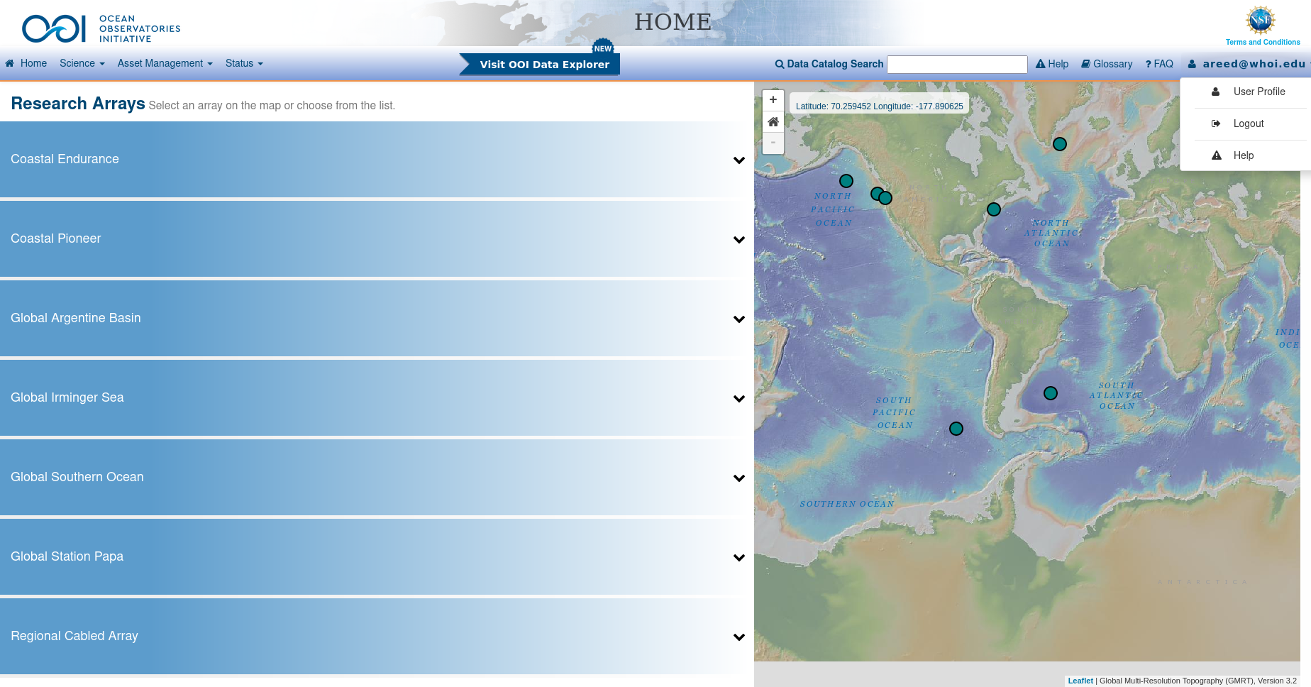
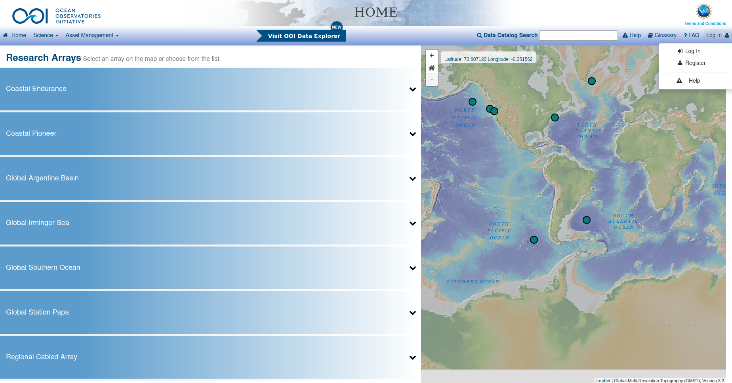
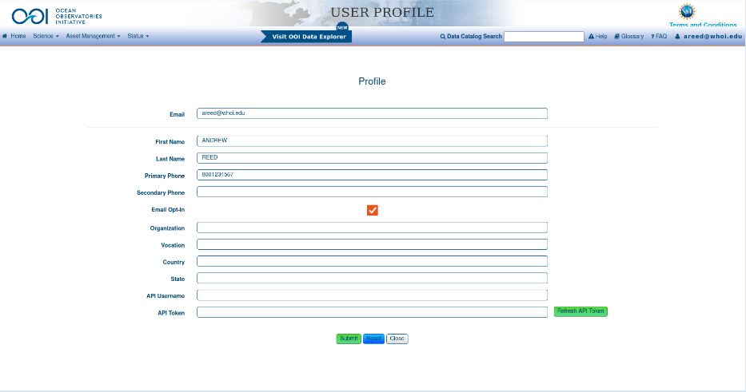
Setup & Requirements
I recommend you do NOT hardcode these values into your scripts/code, especially if you use gitHub or another versioning system that is public.
“login”
“password”

Slide 5
Data/Metadata Access (Handout: API Cheat Sheet)
Category | Access point | Description
Deployment | 12587/events/deployment/inv/ | Access deployment numbers as well as the asset & calibration info for specified instrument & deployment, and deployment times/cruises
 | 12587/asset/deployments | Asset & calibration info for all deployment for the specified UID
Calibration | 12587/asset/cal?uid= OR ?assetid= | Return all calibration info for a given uid or assetId
 | 12587/asset/cal?refdes= | Return list of deployments with calibrations for a given reference designator
Asset | 12587/asset?uid= OR ?serialnumber= | Asset information by unique id or instrument serial number
Preload | 12575/parameter/ | Retrieve information for a parameter (i.e. variable) given its ID number
 | 12575/stream/byname/ | Retrieve information for a stream given its name
Annotations | /12580/anno/find?= | Retrieve annotations for a specific time period and for a given reference designator (optional: stream and method)
Vocab | 12586/vocab/inv/ | Get the vocabulary (descriptions) for a sensor
Data | 12576/sensor/inv/ | Can access the data from OOI using either a synchronous (returns JSON; limited to 20000 data points) or asynchronous (returns netCDF, CSV, or JSON; not data limit)
Metadata
A dictionary with all the parameters, times,
Preload
Asset
Deployment
Calibrations
Annotations

Slide 6
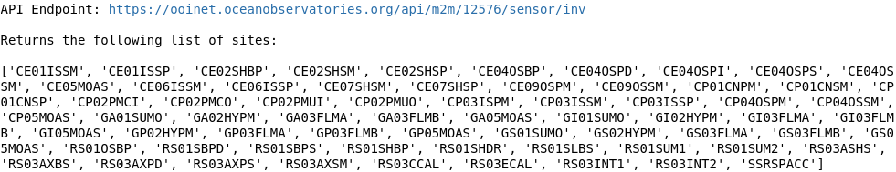
Finding Data: Step 1
Endpoint: m2m/12576/sensor/inv
Select a site, e.g. Global Ocean Station Papa Flanking Mooring A (GP03FLMA)

Slide 7
Finding Data: Step 2
Endpoint: m2m/12576/sensor/inv/GP03FLMA
Returns two nodes: the mooring sphere (RIS01) and the riser (RIM01)
Select a node: Global Ocean Station Papa Flanking Mooring A - Mooring Sphere (GP03FLMA-RIS01)

Slide 8
Finding Data: Step 3 (Handout: Instrument List)
Endpoint: m2m/12576/sensor/inv/GP03FLMA/RIS01
Returns four sensors:
00-SIOENG000 - engineering data w/no scientific interest
03-DOSTAD000 - dissolved oxygen sensor
04-PHSENF000 - pH sensor
05-FLORTD000 - fluorescense/chlorophyll/turbidity sensor
We’re going to select the oxygen sensor ‘03-DOSTAD000’. This also allows us to construct the Reference Designator: GP03FLMA-RIS01-03-DOSTAD000

Slide 9
Finding Data: Step 4
Endpoint: m2m/12576/sensor/inv/GP03FLMA/RIS01/03-DOSTAD000
Returns the data delivery methods:
recovered_host: this is data recorded by the mooring computer and downloaded after recovering the mooring
telemetered: this is data that was transmitted from the mooring back-to-shore. For some instruments it is truncated or decimated.

Slide 10
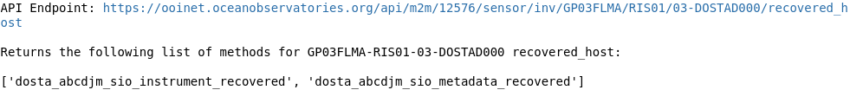
Finding Data: Step 5
Endpoint: m2m/12576/sensor/inv/GP03FLMA/RIS01/03-DOSTAD000/recovered_host
Returns the data streams:
dosta_abcdjm_sio_instrument_recovered - this stream has science data
dosta_abcdjm_sio_metadata_recovered - this stream has metadata
Now we can go ahead and request data!
Full data request: m2m/12576/sensor/inv/GP03FLMA/RIS01/03-DOSTAD000/recovered_host/dosta_abcdjm_sio_instrument_recovered

Slide 11
Requesting Data: Synchronous
Synchronous data request
Faster
Returned as JSON
Request Specifications
limit (required): specifies number of data points with a maximum of 20000
beginDT (optional): start date as YYYY-mm-ddTHH:MM:SS.fffZ format
endDT (optional): end date in same format as beginDT
parameters (optional): numeric IDs of which parameters to get

Slide 12
Requesting Data: Synchronous
Building a request
Want dissolved oxygen data for the year of 2015 from Ocean Station Papa Flanking Mooring A oxygen sensor
Specifications
limit: 20000
beginDT: 2015-01-01T00:00:00.000Z
endDT: 2016-01-01T00:00:00.000Z
parameters: 7 (time), 14 (dissolved oxygen)
Example Request
m2m/12576/sensor/inv/GP03FLMA/RIS01/03-DOSTAD000/recovered_host/dosta_abcdjm_sio_instrument_recovered?limit=20000&beginDT=2015-01-01T00:00:00.000Z&endDT=2016-01-01T00:00:00.000Z&parameters=7,14
IMPORTANT: If you specify parameters, you must also specify time (“7”) or it will not be included!

Slide 13
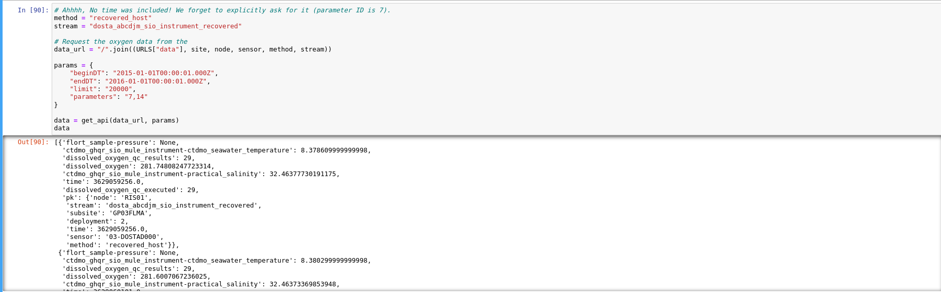
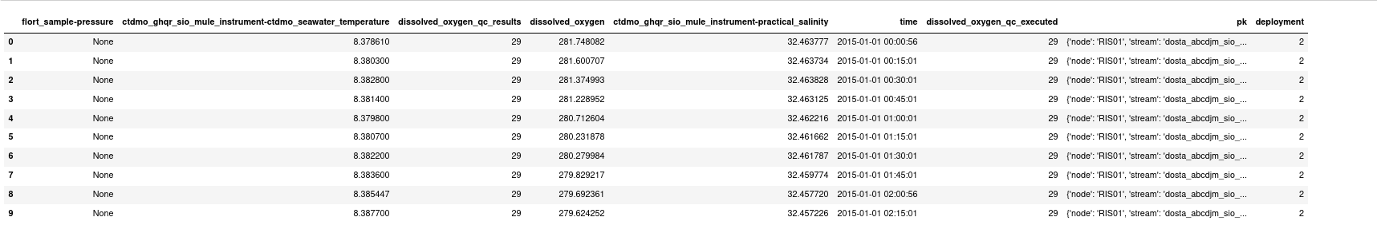
Requesting Data: Synchronous
Step 1: Request the data
Step 2: Data as JSON object
Desired parameter (dissolved oxygen)
Step 3: Parse JSON
Data from co-located sensors needed in calculation of desired parameter

Slide 14
Requesting Data: Asynchronous
Asynchronous data request
Slower
Can return data as either JSON, CSV, or as netCDF (default)
No data point limit
Request Specifications
limit (required): if not specified, defaults netCDF
beginDT (optional): start date as YYYY-mm-ddTHH:MM:SS.fffZ format
endDT (optional): end date in same format as beginDT
parameters (optional): numeric IDs of which parameters to get
include_provenance (optional, default False): include a provenance file which specifies data processing paths
include_annotations (optional, default False): include a file with data annotations

Slide 15
Requesting Data: Asynchronous
Building a request
Want dissolved oxygen data for the year of 2015 from Ocean Station Papa Flanking Mooring A oxygen sensor
Specifications
beginDT: 2015-01-01T00:00:00.000Z
endDT: 2016-01-01T00:00:00.000Z
parameters: 7 (time), 14 (dissolved oxygen)
Example Request
m2m/12576/sensor/inv/GP03FLMA/RIS01/03-DOSTAD000/recovered_host/dosta_abcdjm_sio_instrument_recovered?beginDT=2015-01-01T00:00:00.000Z&endDT=2016-01-01T00:00:00.000Z&parameters=7,14

Slide 16
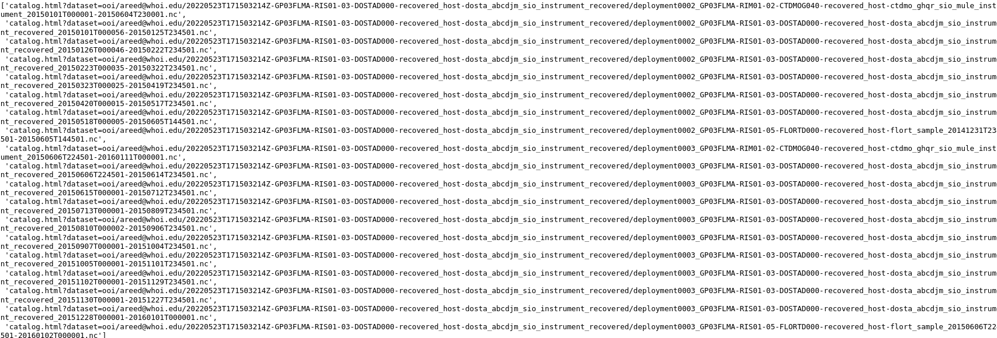
Requesting Data: Asynchronous
Step 1: Get THREDDS server url from M2M
Step 2: Get dataset catalog using THREDDS server url

Slide 17
Requesting Data: Asynchronous
See Chris Wingard’s Breakout session
“Navigating THREDDS & ERDDAP”
for more info

Slide 18
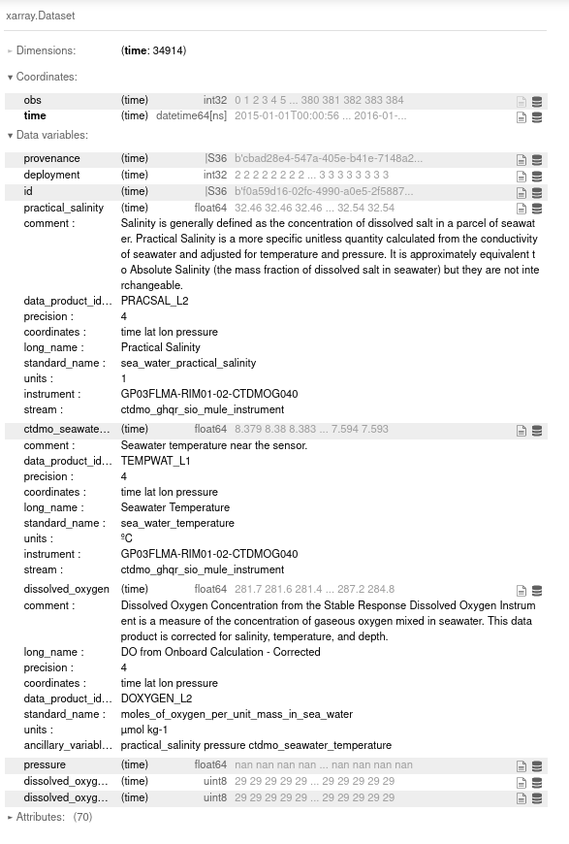
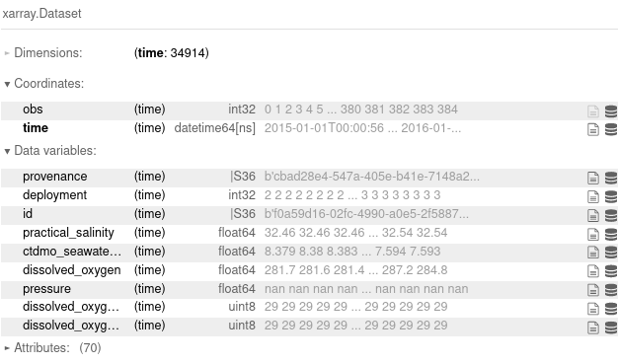
Requesting Data: Asynchronous
Opened netCDF files as a dataset using xarray:

Slide 19
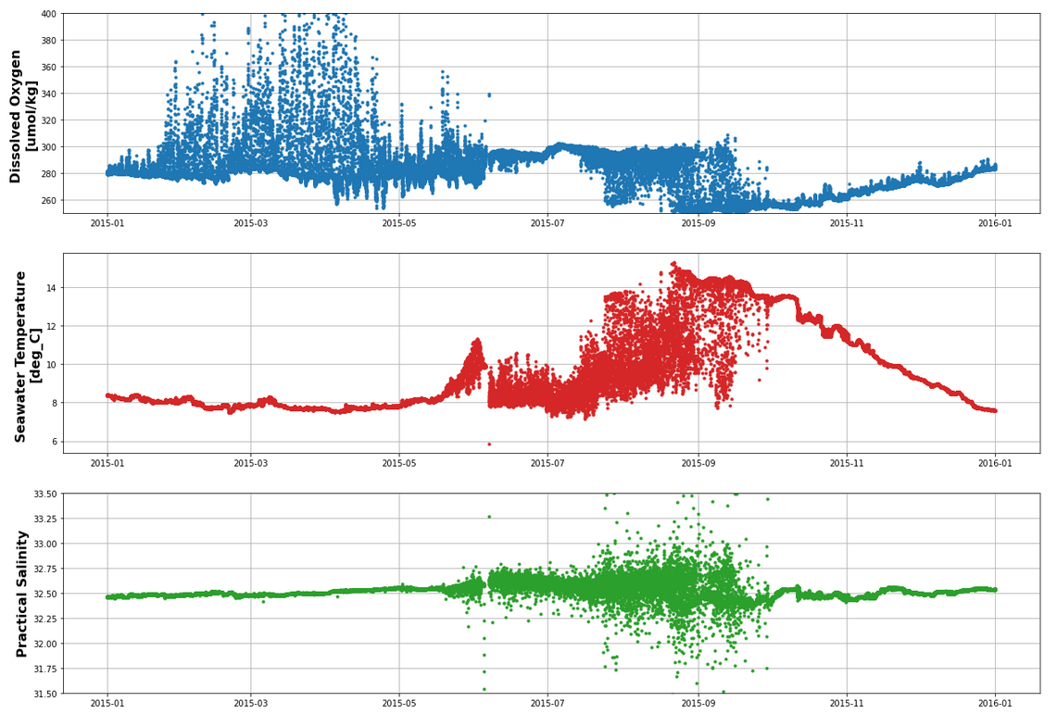
The Data

Slide 20
Annotations
Human-in-the-loop Assessment
Added to the datasets for specified time periods by the operators
Provide info on data quality, performance, issues, and context
Available from the OOI Data Portal
Request
Endpoint: https://ooinet.oceanobservatories.org/api/m2m/12580/anno/find
Parameters
refdes (required): reference designator
beginDT & endDT (optional): must be unix epoch time as microseconds
method (optional): only returns annotations for the given method for a given reference designator
stream (optional): only returns annotations for the given data stream for a given reference designator - stream

Slide 21
Annotations
Example Request
Annotations for Ocean Station Papa Flanking Mooring A oxygen sensor from 2015-01-01 to 2016-01-01
Request url: https://ooinet.oceanobservatories.org/api/m2m/12580/anno/find?refdes=GP03FLMA-RIS01-02-DOSTAD000&beginDT=1420088401000&endDT=1451624401000
Answer to noisy data: Biofouling!

Slide 22
Metadata: Calibrations
Reference Designator based
Since individual instruments are swapped during each mooring deployment & recovery, the calibration coefficients for a reference designator are different for each deployment. The way OOI operates is that it loads all the available calibration coefficients for a given reference designator.
Recommend that limit an individual request to a single deployment - otherwise get a lot of calibrations
Example request for Global Ocean Station Papa Flanking Mooring A oxygen optode for deployment 6
Request url: https://ooinet.oceanobservatories.org/api/m2m/12587/asset/cal?refdes=GP03FLMA-RIS01-DOSTAD000&beginDT=2018-08-29T22:25:00.000Z&endDT=2018-08-30T22:54:00.000Z

Slide 23
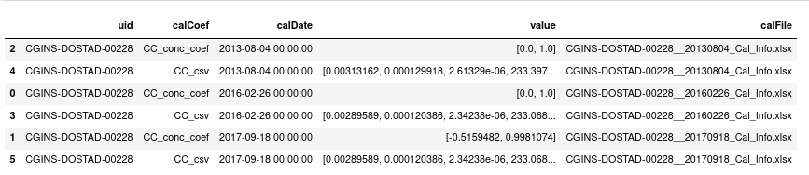
Metadata: Calibrations
Unique Identifier (UID) based
Return a list for all of the calibrations available in the system for a particular instrument
Request data for oxygen sensor with UID CGINS-DOSTAD-00228
Request url: https://ooinet.oceanobservatories.org/api/m2m/12587/asset/cal?=CGINS-DOSTAD000-00228

Slide 24
Metadata: Deployments
Provide information on deployment numbers, times, cruises, and what instrument was deployed
A deployment is defined as span of time a mooring or instrument were deployed and then recovered
Reference Designator based
Request deployments for Global Ocean Station Papa Flanking Mooring A oxygen optode
Request url: https://ooinet.oceanobservatories.org/api/m2m/12587/events/deployment/inv/GP03FLMA/RIS0103-DOSTAD000
If no deployment number is given, returns a list of available deployments

Slide 25
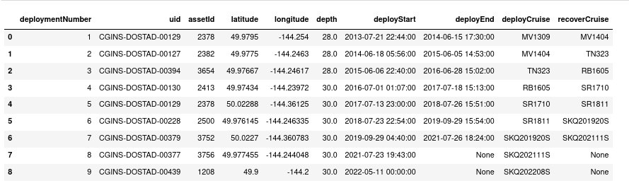
Metadata: Deployments
Recommended to add in the deployment number
Request deployment 6 for Global Ocean Station Papa Flanking Mooring A oxygen optode
Request url: https://ooinet.oceanobservatories.org/api/m2m/12587/events/deployment/inv/GP03FLMA/RIS0103-DOSTAD000
Can iterate through each deployment to build a table

Slide 26
Metadata: Vocab
OOI Vocabulary
Provides more detailed information on the reference designator
Includes the description names of the instrument at that reference designator, the array, the mooring, and node, as well as nomica
Request vocab for Global Ocean Station Papa Flanking Mooring A oxygen
Example url: https://ooinet.oceanobservatories.org/api/m2m/12586/vocab/inv/GP03FLMA/RIS01/03-DOSTAD000

Slide 27
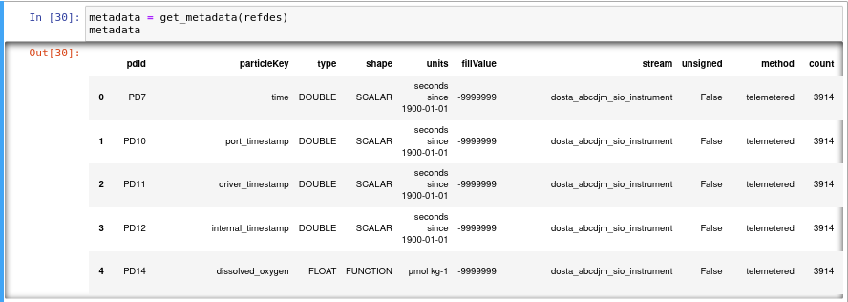
Metadata: Metadata
The metadata contains such valuable information such as the available methods and streams (which are required to download the data), the particleKeys (the data variable names), parameter IDs, number of particles (data points), and the associated units
Example request for Global Ocean Station Papa Flanking Mooring A oxygen
https://ooinet.oceanobservatories.org/api/m2m/12587/asset/cal?refdes=GP03FLMA-RIS01-DOSTAD000&beginDT=2018-08-29T22:25:00.000Z&endDT=2018-08-30T22:54:00.000Z
Results returns a table with 54 entries!

Slide 28
Preload: Metadata & Data Levels
Data Levels refer to the level of processing that the given data parameter has undergone
Level 1, or L1 Data Products, are derived from L0 data, and provide data that has been calibrated using vendor-provided values or values derived from pre-deployment procedures, and that is in scientific units
Level 2, or L2 Data Products are derived quantities created via an algorithm that draws on multiple L1 Data Products. L2 data products may be based on data from the same or a combination of separate instruments.
Preload
Contains detailed information on each parameter, queried based on the parameter ID
Get annotations for the GP03FLMA-RIS01-02-DOSTAD000 dissolved_oxygen (parameter ID = “14”)
Example request: https://ooinet.oceanobservatories.org/api/m2m/12575/parameter/14

Slide 29
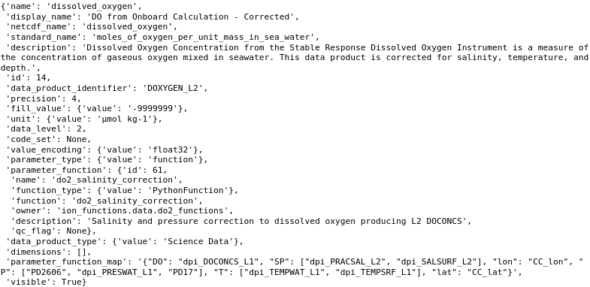
Preload: Metadata & Data Levels
Example request: https://ooinet.oceanobservatories.org/api/m2m/12575/parameter/14

Slide 30
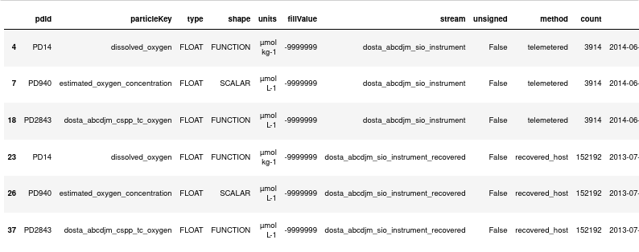
Metadata & Preload
With the Data Levels queried from Preload for each of the parameters returned with the Metadata, we can filter for the different Data Levels. Below we filtered the metadata for the GP03FLMA-RIS01-03-DOSTAD000 for L1 & L2 data products
This allows us to cut down on the size of the data request and resulting data files
Important: Notice that time was filtered out. This is because they don't have a defined data product level. An additional wrinkle is that time is NOT the default dimension of delivered netCDF files - this means it needs to be specifically requested for data requests. This is something to be aware of when requesting only specific data variables.

Slide 31
Further Information
Presentation available on gitHub at github.com/reedan88/OOI-NE-Pacific-Community-Workshop
Includes python package for simplified interaction with the OOI M2M & example notebook
Also includes jupyter scripts used to create “Global Ocean Station Papa: Assets & Datasets” poster
OOI Data Explorations
Available on the OOI github at github.com/oceanobservatories/ooi-data-explorations
Includes code to both request and process data from OOI as well as some QC routines
Code in both python, MatLab, and R
Supplemental & Complementary Datasets
Discrete water sampling data available on the OOI Alfresco Web Document Server
alfresco.oceanobservatories.org: OOI > Array > Cruise Data > Cruise > Ship Data > Water Sampling
Other Sources for OOI Data
OOI Data Explorer website & ERDDAP server - see “Data Explorer” Breakout Session
Raw Data Server, Camera Data, & Hydrophone Data - see “Raw Data Server” Breakout Session

Slide 32



Questions?

